Slide 1

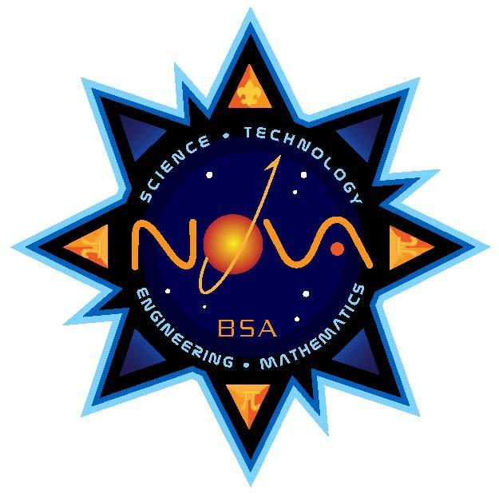
Illinois Novaree
A Sponsorship Opportunity

Slide 2
What Is The Novaree?
An event By Engineers, For (future) Engineers
Bringing together passionate teachers and curious students
All manpower from within university
12 Registered Student Organizations
14 Merit Badges, all four Nova Awards
Nova Awards - BSA’s new STEM Initiative

Slide 3
What We Can Do For You
Quality food for quality teachers
Word of Mouth Marketing
Mentioned at the start of each day/At Lunch
Logo on Volunteer and Participant T-shirts

Slide 4
What You Can Do For Us
Volunteers:
Are all Students
Work hard to keep the clinic running smoothly
Deserve a reward for their efforts

